Slide 1
Cable Design Project
Define a 3 cable system to lift truck.
Must lift from two corners and the opposite midpoint.
Team 1
Autumn Murphy, Zach Anderson, Shane Miller

Slide 2
Plan of Action
State given information
Declare position
Find Position vectors
Find unit vectors
Use E of E to solve

Slide 3
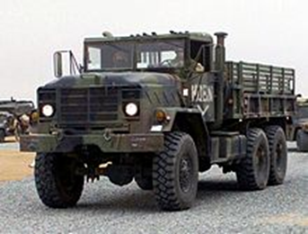
Truck Information
Truck dimensions
Length = 307.4 in.
Width = 97.5 in.
Height = 115 in.
Weight = 5000 lbs.
Weight acts at center of truck

Slide 4
Platform Information
Platform Dimensions
Platform length = 353.4 in.
Platform width = 143.5 in.
Platform weight = 5000 lbs.
Weight acts at center of platform

Slide 5
Lifting Hook
Lifting hook is located above platform at 230 in.
Being attached to 3 cable connected to a platform.
For now, assume that cables attached to the outer edges of the plates will not contact the truck.

Slide 6
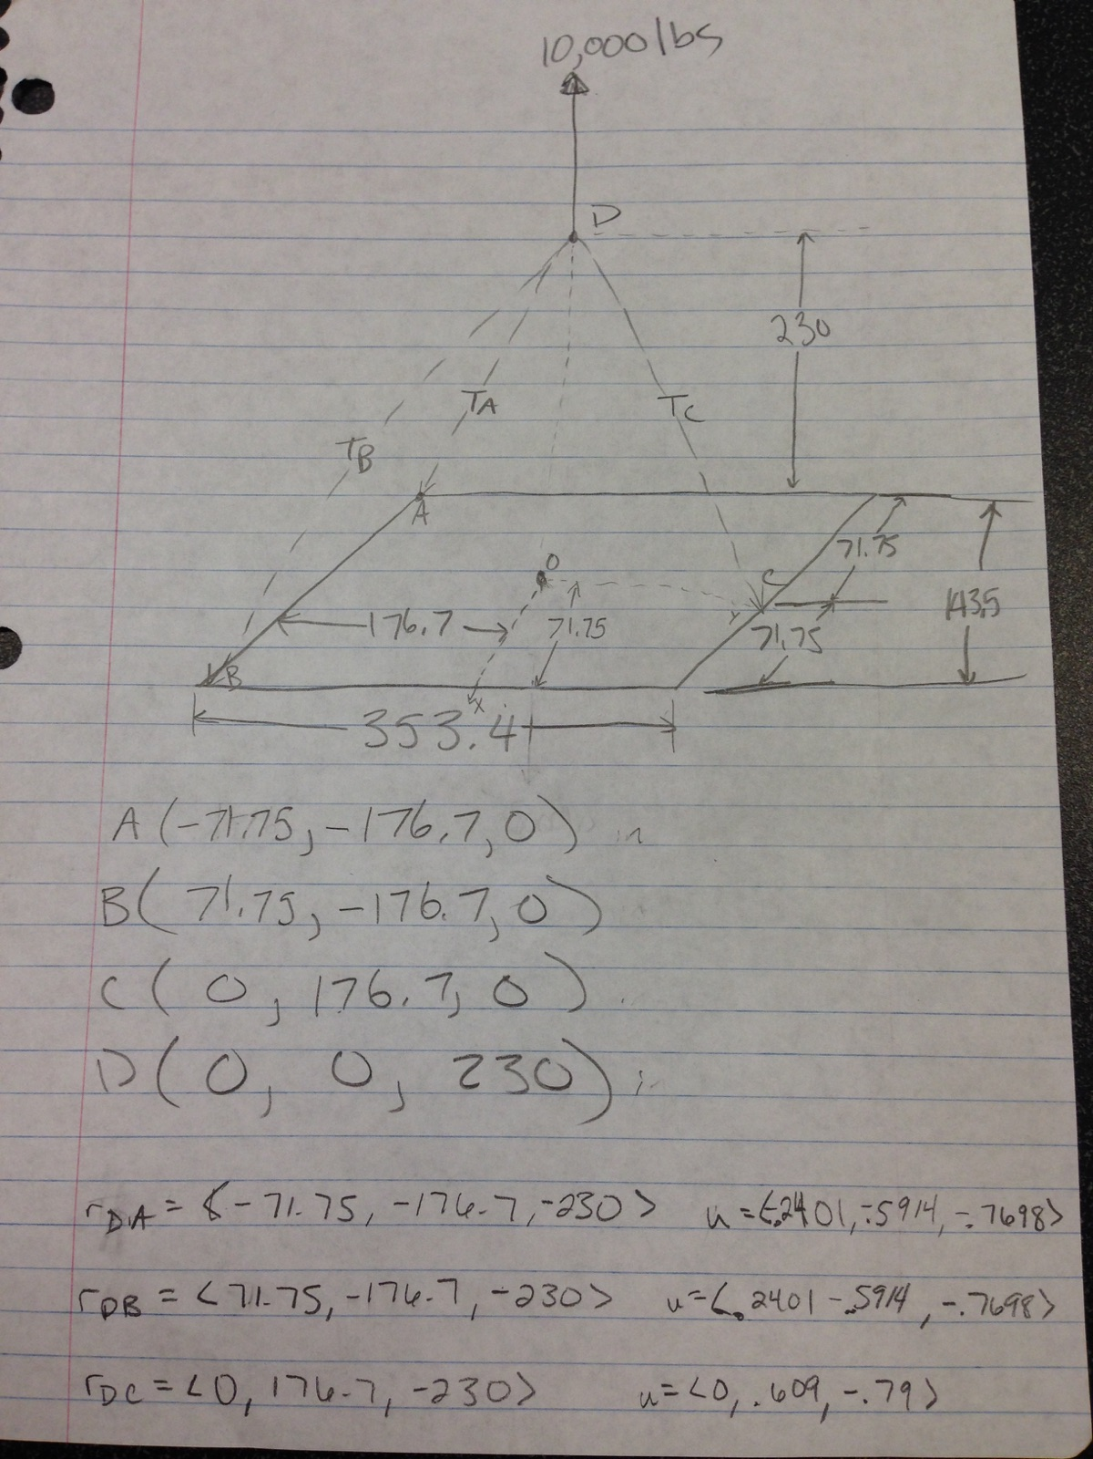
FBD of Platform
Origin set at center of platform

Slide 7
Calculating Forces in Cables

Slide 8
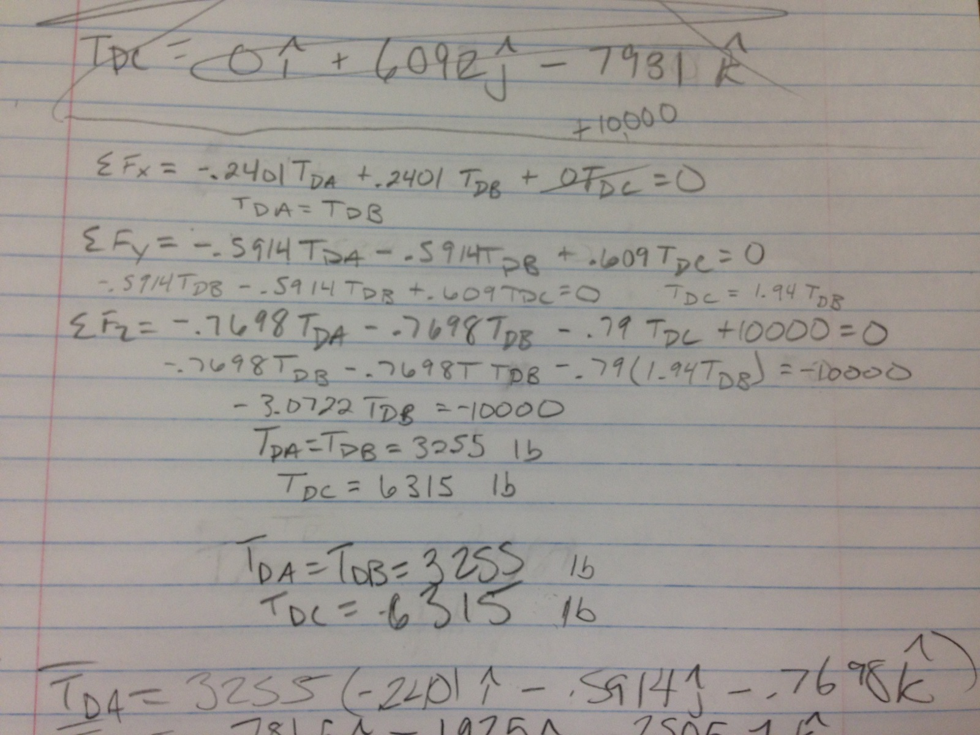
Calculating Forces in Cables

Slide 9
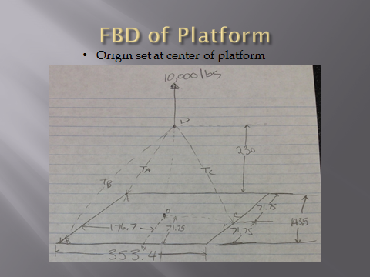
Weight on the Cables
Cables DA & DB carry 3255 lbs.
Cable DC carries 6315 lbs.

Slide 10
Tension on Mars
 | Earth |  | Mars
Tda= | 3255 | lb | 1236.9 | lb
Tdb= | 3255 | lb | 1236.9 | lb
Tdc= | 6315 | lb | 2399.7 | lb

Slide 11
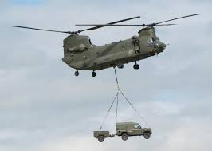
The End

